Slide 1
Morphology
Last updated: 4-11-21
Gonzalez R. C., Woods R. E., Eddins S. L., Digital Image Processing Using Matlab, Pearson Education, 2nd edition, 2009. (Ch. 9)
Gonzalez R. C., Woods R. E., Eddins S. L., Digital Image Processing, Pearson Education, 3rd edition, 2007. (Ch. 9)
$ Szeliski R., Computer Vision - Algorithms and Applications, Springer, 2011. (Ch. 3)
# For the graduate level course
@ For DIP students only
$ For CV students only
Notes:
http://www.comp.dit.ie/bmacnamee/gaip.htm

Slide 2
Contents
Once segmentation is complete, morphological operations can be used to remove imperfections in the segmented image and provide information on the form and structure of the image
In this lecture we will consider
What is morphology?
Simple morphological operations
Compound operations
Morphological algorithms

Slide 3
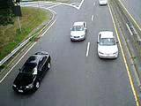
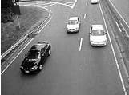


0, 1, Black, White?
Throughout all of the following slides whether 0 and 1 refer to black or white is a little interchangeable.
All of the discussion that assumes segmentation has already taken place and that images are made up of 0s for background pixels and 1s for object pixels
After this, it doesn’t matter if 0 is black, white, yellow, green…….

Slide 4
What Is Morphology?
Morphological image processing (or morphology) describes a range of image processing techniques that deal with the shape (or morphology) of features in an image.
Morphological operations are typically applied to remove imperfections introduced during segmentation, and so typically operate on bi-level images.

Slide 5

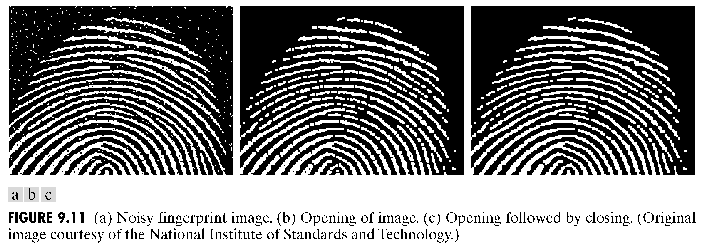
Quick Example
Images taken from Gonzalez & Woods, Digital Image Processing (2002)
Image after segmentation
Image after segmentation and morphological processing

Slide 6
Mathematic Morphology
used to extract image components that are useful in the representation and description of region shape, such as;
boundaries extraction
skeletons
convex hull
morphological filtering
thinning
pruning

Slide 7
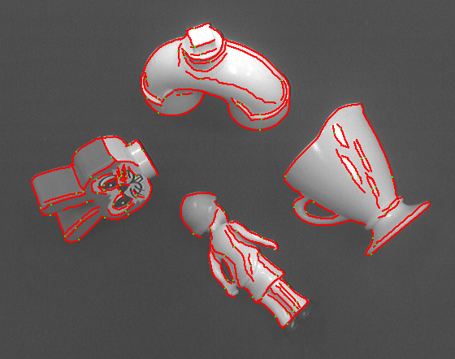
Mathematic Morphology
Boundaries Extraction
Skeletons

Slide 8
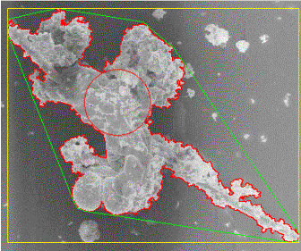
Mathematic Morphology
Convex hull
Morphological Filtering

Slide 9

Mathematic Morphology
Thinning
Pruning

Slide 10
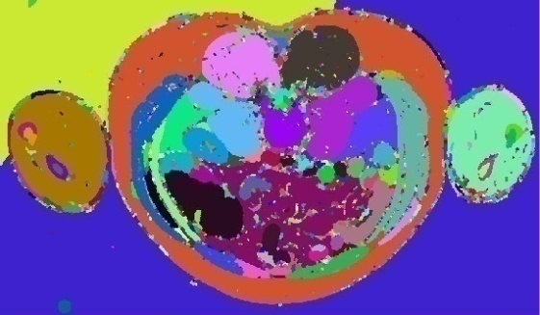
Mathematic Morphology
The mathematical framework used for:
Pre-processing
noise filtering, shape simplification, ...
Enhancing object structure
skeletonization, convex hull...
Segmentation
watershed, region growing, …
Quantitative description
area, perimeter, circularity, ...

Slide 11
Structuring Elements, Hits & Fits
B
Structuring Element
Fit: All on pixels in the structuring element cover on pixels in the image
Hit: Any on pixel in the structuring element covers an on pixel in the image
Miss: No on pixel in the structuring element covers an on pixel in the image
A
C
All morphological processing operations are based on these simple ideas

Slide 12
Structuring Elements
Structuring elements can be any size and make any shape.
However, for simplicity, I will use square structuring elements with their origin at the middle pixel.
0 | 0 | 1 | 0 | 0
0 | 1 | 1 | 1 | 0
1 | 1 | 1 | 1 | 1
0 | 1 | 1 | 1 | 0
0 | 0 | 1 | 0 | 0
1 | 1 | 1
1 | 1 | 1
1 | 1 | 1
0 | 1 | 0
1 | 1 | 1
0 | 1 | 0

Slide 13
Fitting & Hitting
0 | 0 | 0 | 0 | 0 | 0 | 0 | 0 | 0 | 0 | 0 | 0
0 | 0 | 0 | 1 | 1 | 0 | 0 | 0 | 0 | 0 | 0 | 0
0 | 0 | 1 | 1 | 1 | 1 | 1 | 0 | 0 | 0 | 0 | 0
0 | 1 | 1 | 1 | 1 | 1 | 1 | 1 | 0 | 0 | 0 | 0
0 | 1 | 1 | 1 | 1 | 1 | 1 | 1 | 0 | 0 | 0 | 0
0 | 0 | 1 | 1 | 1 | 1 | 1 | 1 | 0 | 0 | 0 | 0
0 | 0 | 1 | 1 | 1 | 1 | 1 | 1 | 1 | 0 | 0 | 0
0 | 0 | 1 | 1 | 1 | 1 | 1 | 1 | 1 | 1 | 1 | 0
0 | 0 | 0 | 0 | 0 | 1 | 1 | 1 | 1 | 1 | 1 | 0
0 | 0 | 0 | 0 | 0 | 0 | 0 | 0 | 0 | 0 | 0 | 0
1 | 1 | 1
1 | 1 | 1
1 | 1 | 1
B
C
Structuring Element 1
0 | 1 | 0
1 | 1 | 1
0 | 1 | 0
A
Structuring Element 2

Slide 14
Fundamental Operations
Fundamentally, morphological image processing is very like spatial filtering.
The structuring element is moved across every pixel in the original image to give a pixel in a new processed image.
The value of this new pixel depends on the operation performed.
There are two basic morphological operations, i.e., erosion and dilation.

Slide 15


Basic morphological operations
Erosion
Dilation
combine to
Opening object
Closing background
keep general shape but smooth with respect to

Slide 16
Erosion
Erosion of image f by structuring element s is given by f  s.
The structuring element s is positioned with its origin at (x, y) and the new pixel value is determined using the rule:

Slide 17
Erosion Example
Original Image
Processed Image With Eroded Pixels
Structuring Element

Slide 18

Erosion Example 1
Original image
Erosion by 3*3 square structuring element
Erosion by 5*5 square structuring element
Watch out: In these examples a 1 refers to a black pixel!

Slide 19
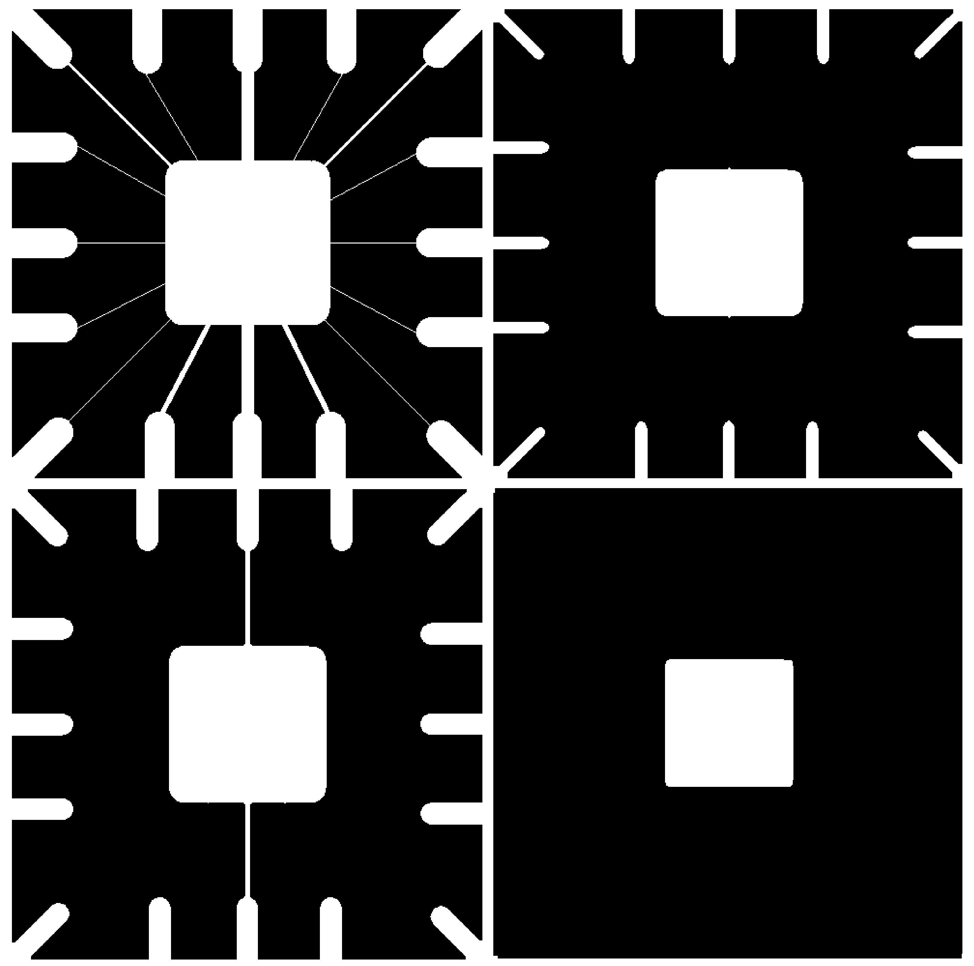
Erosion Example 2
Original image
After erosion with a disc of radius 10
Images taken from Gonzalez & Woods, Digital Image Processing (2002)
After erosion with a disc of radius 5
After erosion with a disc of radius 20

Slide 20
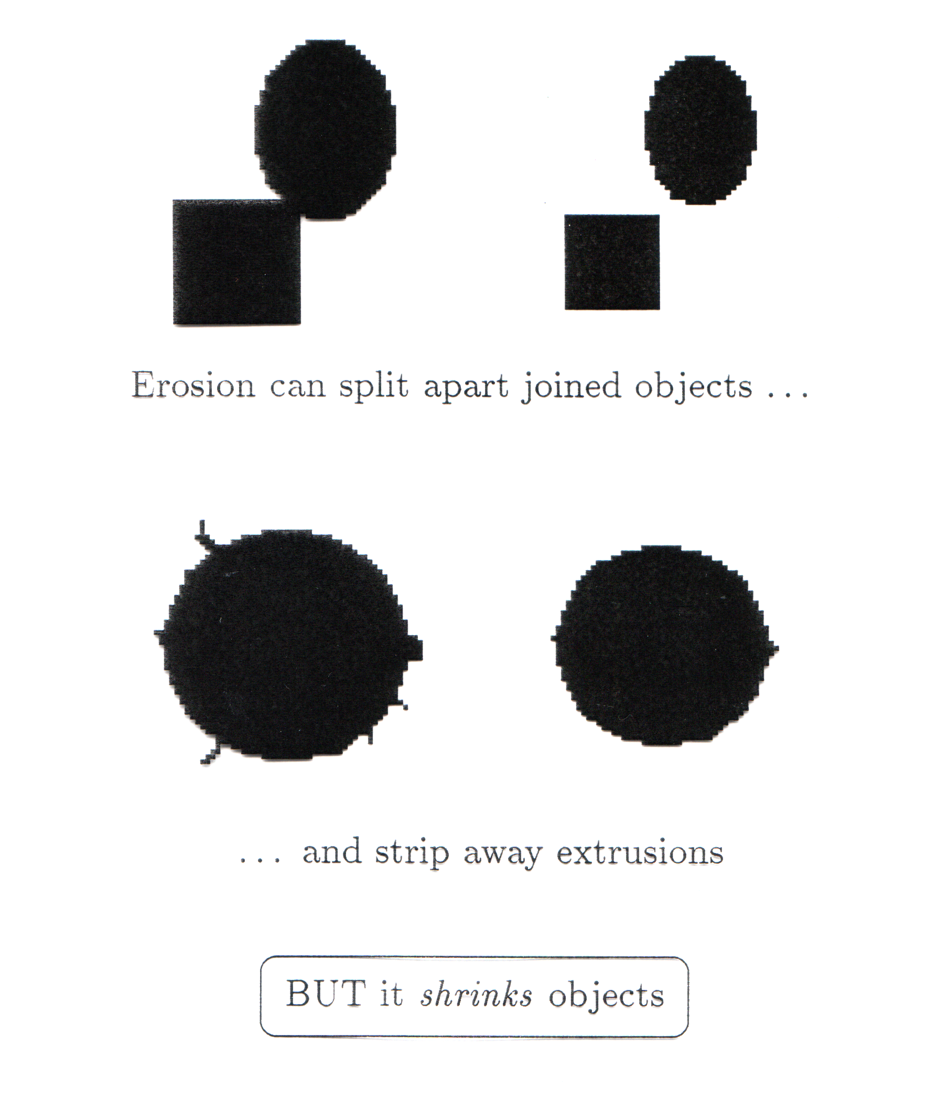
What Is Erosion For?
Erosion can split apart joined objects
Erosion can strip away extrusions
Watch out: Erosion shrinks objects
Erosion can split apart

Slide 21
Dilation
Dilation of image f by structuring element s is given by f s
The structuring element s is positioned with its origin at (x, y) and the new pixel value is determined using the rule:

Slide 22
Dilation Example
Original Image
Processed Image
Structuring Element

Slide 23
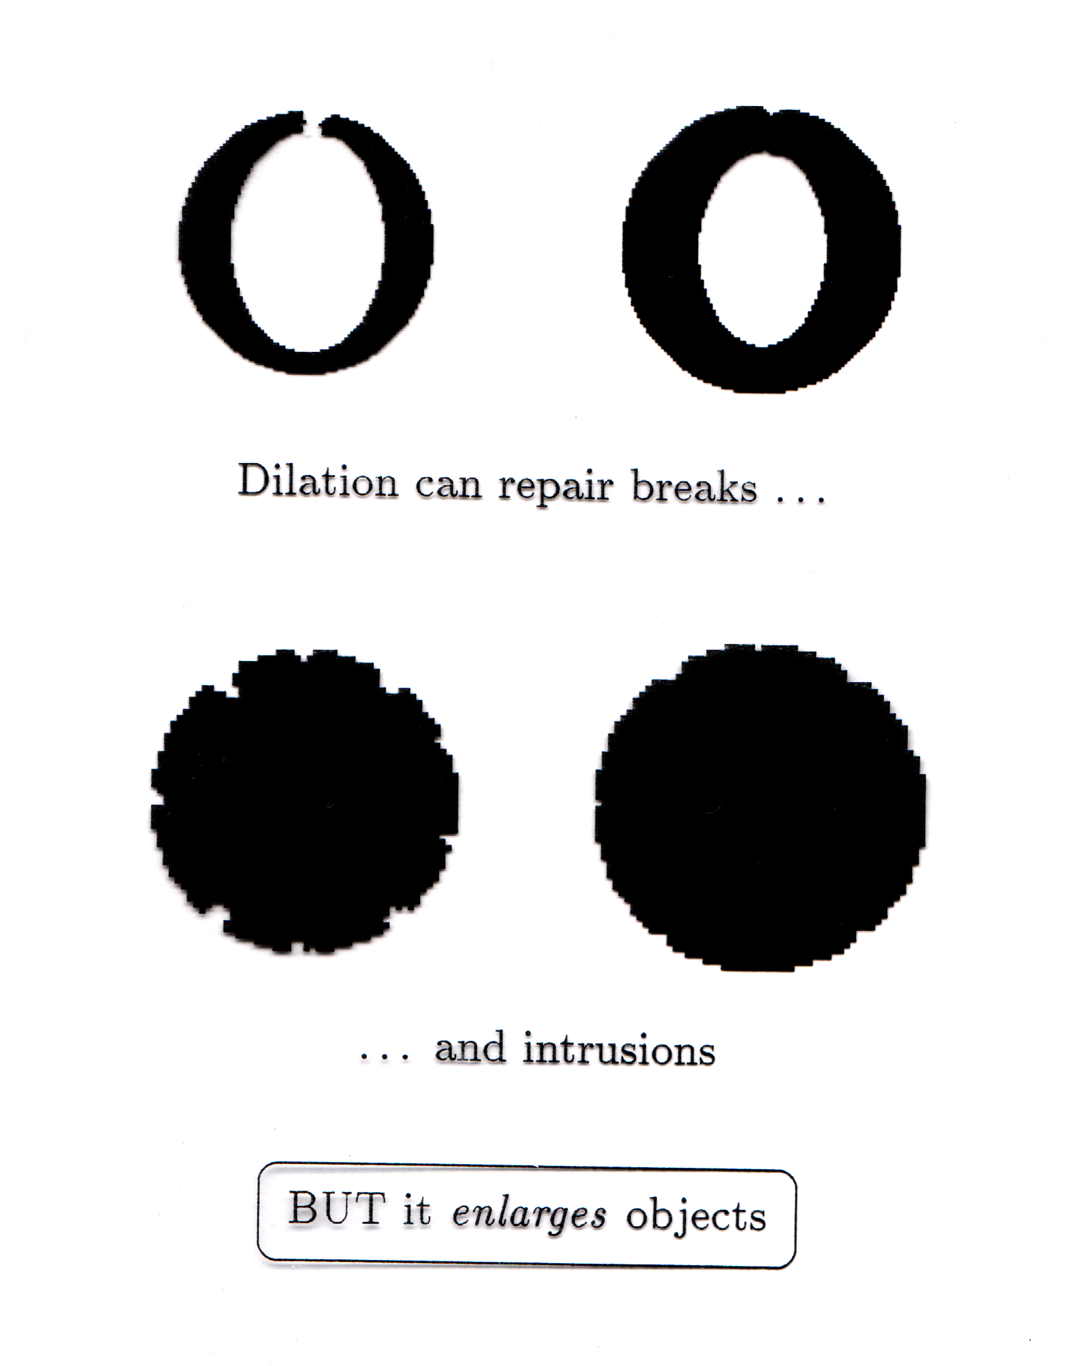
What Is Dilation For?
Dilation can repair breaks
Dilation can repair intrusions
Watch out: Dilation enlarges objects

Slide 24

Dilation Example 1
Original image
Dilation by 3*3 square structuring element
Dilation by 5*5 square structuring element
Watch out: In these examples a 1 refers to a black pixel!

Slide 25
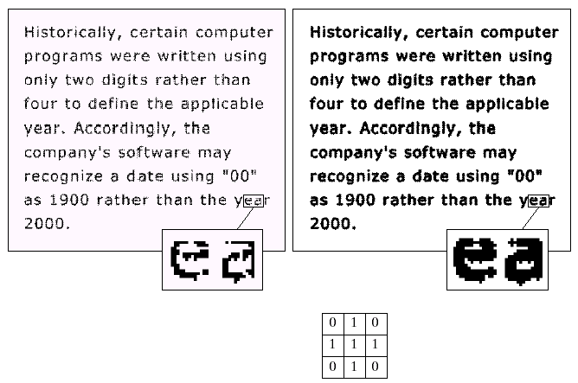
Dilation Example 2
Original image
After dilation
Images taken from Gonzalez & Woods, Digital Image Processing (2002)
Structuring element

Slide 26
Exercises
Do the process of dilation on book-text.tif and compare your result with Fig. 9.6 (Gonzales).
Do the process of erosion on wirebond.tif and compare your result with Fig. 9.8 (Gonzales).
Note: Download images from www.imageprocessingplace.com

Slide 27
Compound Operations
More interesting morphological operations can be performed by performing combinations of erosions and dilations
The most widely used of these compound operations are:
Opening
Closing

Slide 28
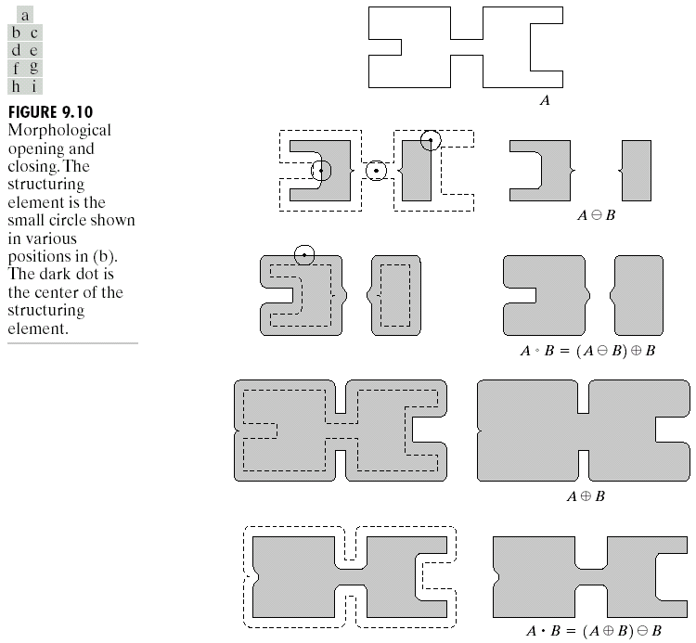
Opening
The opening of image f by structuring element s, denoted f ○ s is simply an erosion followed by a dilation
f ○ s = (fs) s
Images taken from Gonzalez & Woods, Digital Image Processing (2002)
Original shape
After erosion
After dilation (opening)
Note a disc shaped structuring element is used

Slide 29

Opening Example
Original Image
Images taken from Gonzalez & Woods, Digital Image Processing (2002)
Image After Opening

Slide 30
Opening Example
Original Image
Processed Image (Erosion)
Structuring Element

Slide 31
Opening Example
Processed Image (Erosion)
Processed Image (Dilation)

Slide 32
Opening Example
Original Image
Processed Image
Structuring Element

Slide 33
Closing
The closing of image f by structuring element s, denoted f • s is simply a dilation followed by an erosion
f • s = (f s)s
Images taken from Gonzalez & Woods, Digital Image Processing (2002)
Original shape
After dilation
After erosion (closing)
Note a disc shaped structuring element is used

Slide 34
Closing Example
Original Image
Images taken from Gonzalez & Woods, Digital Image Processing (2002)
Image After Closing

Slide 35
Closing Example
Original Image
Processed Image
Structuring Element

Slide 36
Closing Example
Original Image
Processed Image
Structuring Element

Slide 37
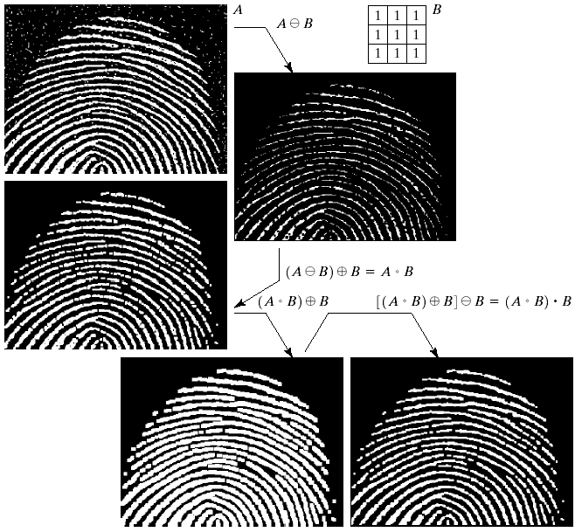
Morphological Processing Example
Images taken from Gonzalez & Woods, Digital Image Processing (2002)

Slide 38
Morphological Algorithms
Using the simple technique we have looked at so far we can begin to consider some more interesting morphological algorithms
We will look at:
Boundary extraction
Region filling
There are lots of others as well though:
Extraction of connected components
Thinning/thickening
Skeletonisation

Slide 39
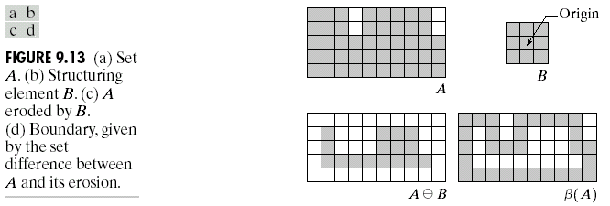
Boundary Extraction
Extracting the boundary (or outline) of an object is often extremely useful
The boundary can be given simply as
β(A) = A – (AB)
Images taken from Gonzalez & Woods, Digital Image Processing (2002)

Slide 40
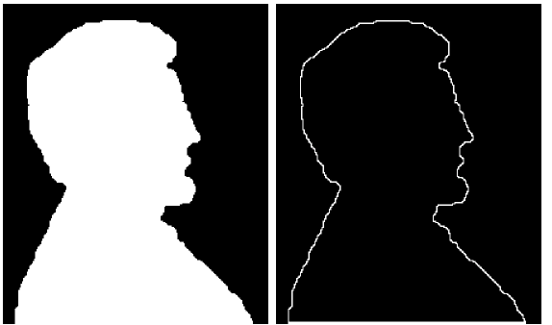
Boundary Extraction Example
A simple image and the result of performing boundary extraction using a square 3*3 structuring element
Images taken from Gonzalez & Woods, Digital Image Processing (2002)
Original Image
Extracted Boundary

Slide 41
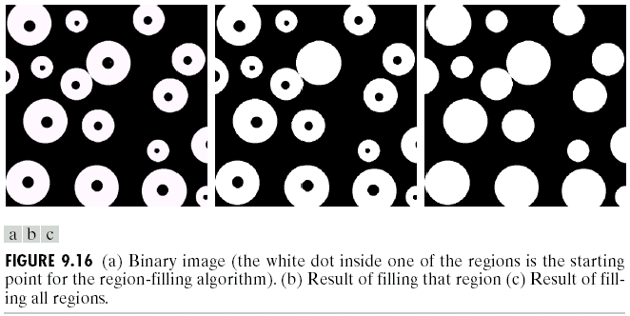
Region Filling
Given a pixel inside a boundary, region filling attempts to fill that boundary with object pixels (1s)
Images taken from Gonzalez & Woods, Digital Image Processing (2002)
Given a point inside here, can we fill the whole circle?

Slide 42
Region Filling (cont…)
The key equation for region filling is
Where X₀ is simply the starting point inside the boundary, B is a simple structuring element and A^{c} is the complement of A
This equation is applied repeatedly until X_{k} is equal to X_{k-1}
Finally the result is unioned with the original boundary

Slide 43
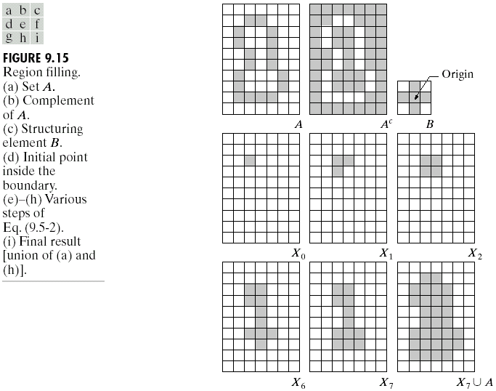
Region Filling Step By Step
Images taken from Gonzalez & Woods, Digital Image Processing (2002)

Slide 44
Region Filling Example
Images taken from Gonzalez & Woods, Digital Image Processing (2002)
Original Image
One Region Filled
All Regions Filled

Slide 45
Summary
The purpose of morphological processing is primarily to remove imperfections added during segmentation
The basic operations are erosion and dilation
Using the basic operations we can perform opening and closing
More advanced morphological operation can then be implemented using combinations of all of these

Slide 46
Exercise - Erosion
Structuring Element

Slide 47
Exercise - Dilation
Structuring Element

Slide 48
Exercise - Opening
Original Image
Processed Image
Structuring Element

Slide 49
Exercise - Closing
Original Image
Processed Image
Structuring Element

Slide 50
Exercise - Boundary Extraction
Structuring Element

Slide 51
Exercise - Region Filling
Structuring Element

Slide 52
Labeling Connected Components
Multiple Objects
Notes:
http://www.cs.cmu.edu/afs/cs/academic/class/15385-s06/lectures/ppts/

Slide 53
Labeling Connected Components
Region Growing Algorithm:
Start with “SEED” point where b(x,y) = 1
Assign LABEL to seed point
Assign SAME LABEL to its Neighbors with b(x,y) = 1
Assign SAME LABEL to Neighbors of Neighbors
Terminates when a component is completely labeled.
Then, pick another UNLABELED seed point.
Notes:
http://www.cs.cmu.edu/afs/cs/academic/class/15385-s06/lectures/ppts/

Slide 54
Labeling Connected Components
To develop computer programs that locate & operate on objects, we need a set of definition for key terms.
N₄(p): the set of 4-neighbors of p
N₈(p): the set of 8-neighbors of p
p
p
Notes:
http://sites.google.com/site/ipum2009/chapter9-code

Slide 55
Labeling Connected Components
Two pixels p & q are said to be:
4-Adjacent if q∈N₄(p)
8-Adjacent if q∈N₈(p)
0 | 0 | 0 | 0 | 0
0 | 0 | 1 | 1 | 1
0 | 0 | 1 | 0 | 0
1 | 1 | 1 | 0 | 0
0 | 0 | 0 | 0 | 0
p
0 | 0 | 0 | 0 | 0
0 | 0 | 1 | 1 | 1
0 | 0 | 1 | 0 | 0
1 | 1 | 0 | 0 | 0
0 | 0 | 0 | 0 | 0
p

Slide 56
Labeling Connected Components
A path between pixels p₁ and p_{n} is a sequence of pixels p₁, p₂,…,p_{n-1}, p_{n} s.t., p_{k} is adjacent to p_{k+1}, for 1≤k<n. A path can be:
4-connected or 8-connected.
Two pixels p & q are said to be 4 (or 8-connectd) if there exist a 4 (or 8-connected) path between them, consisting entirely of foreground pixels.
0 | 0 | 0 | 0 | 0
0 | 0 | 1 | 1 | 1
0 | 0 | 1 | 0 | 0
1 | 1 | 1 | 0 | 0
0 | 0 | 0 | 0 | 0
p
0 | 0 | 0 | 0 | 0
0 | 0 | 1 | 1 | 1
0 | 0 | 1 | 0 | 0
1 | 1 | 0 | 0 | 0
0 | 0 | 0 | 0 | 0
p

Slide 57
Labeling Connected Components
The term connected component was just defined in terms of a path, and the definition of a path in turn depends on adjacency.

Slide 58
Labeling Connected Components
1 | 1 | 1 | 0 | 0 | 0 | 0 | 0
1 | 1 | 1 | 0 | 1 | 1 | 0 | 0
1 | 1 | 1 | 0 | 1 | 1 | 0 | 0
1 | 1 | 1 | 0 | 0 | 0 | 1 | 0
1 | 1 | 1 | 0 | 0 | 0 | 1 | 0
1 | 1 | 1 | 0 | 0 | 0 | 1 | 0
1 | 1 | 1 | 0 | 0 | 1 | 0 | 0
1 | 1 | 1 | 0 | 0 | 0 | 0 | 0
1 | 1 | 1 | 0 | 0 | 0 | 0 | 0
1 | 1 | 1 | 0 | 2 | 2 | 0 | 0
1 | 1 | 1 | 0 | 2 | 2 | 0 | 0
1 | 1 | 1 | 0 | 0 | 0 | 4 | 0
1 | 1 | 1 | 0 | 0 | 0 | 4 | 0
1 | 1 | 1 | 0 | 0 | 0 | 4 | 0
1 | 1 | 1 | 0 | 0 | 3 | 0 | 0
1 | 1 | 1 | 0 | 0 | 0 | 0 | 0
p
Four 4-Connected Components Label Matrix
>> f = [1 1 1 0 0 0 0 0; 1 1 1 0 1 1 0 0; 1 1 1 0 1 1 0 0; 1 1 1 0 0 0 1 0; 1 1 1 0 0 0 1 0; 1 1 1 0 0 0 1 0; 1 1 1 0 0 1 0 0; 1 1 1 0 0 0 0 0];
>> [L, n]= bwlabel(f, 4) % L is exactly label matrix & n is number of labels

Slide 59
Labeling Connected Components
1 | 1 | 1 | 0 | 0 | 0 | 0 | 0
1 | 1 | 1 | 0 | 1 | 1 | 0 | 0
1 | 1 | 1 | 0 | 1 | 1 | 0 | 0
1 | 1 | 1 | 0 | 0 | 0 | 1 | 0
1 | 1 | 1 | 0 | 0 | 0 | 1 | 0
1 | 1 | 1 | 0 | 0 | 0 | 1 | 0
1 | 1 | 1 | 0 | 0 | 1 | 0 | 0
1 | 1 | 1 | 0 | 0 | 0 | 0 | 0
1 | 1 | 1 | 0 | 0 | 0 | 0 | 0
1 | 1 | 1 | 0 | 2 | 2 | 0 | 0
1 | 1 | 1 | 0 | 2 | 2 | 0 | 0
1 | 1 | 1 | 0 | 0 | 0 | 2 | 0
1 | 1 | 1 | 0 | 0 | 0 | 2 | 0
1 | 1 | 1 | 0 | 0 | 0 | 2 | 0
1 | 1 | 1 | 0 | 0 | 2 | 0 | 0
1 | 1 | 1 | 0 | 0 | 0 | 0 | 0
p
Four 8-Connected Components Label Matrix
>> f = [1 1 1 0 0 0 0 0; 1 1 1 0 1 1 0 0; 1 1 1 0 1 1 0 0; 1 1 1 0 0 0 1 0; 1 1 1 0 0 0 1 0; 1 1 1 0 0 0 1 0; 1 1 1 0 0 1 0 0; 1 1 1 0 0 0 0 0];
>> [L, n]= bwlabel(f, 8)

Slide 60
Labeling Connected Components
>> [r, c] = find(L==2)
r =
2
3
2
3
7
4
5
6
c =
5
5
6
6
6
7
7
7
1 | 1 | 1 | 0 | 0 | 0 | 0 | 0
1 | 1 | 1 | 0 | 2 | 2 | 0 | 0
1 | 1 | 1 | 0 | 2 | 2 | 0 | 0
1 | 1 | 1 | 0 | 0 | 0 | 2 | 0
1 | 1 | 1 | 0 | 0 | 0 | 2 | 0
1 | 1 | 1 | 0 | 0 | 0 | 2 | 0
1 | 1 | 1 | 0 | 0 | 2 | 0 | 0
1 | 1 | 1 | 0 | 0 | 0 | 0 | 0
>> rbar = mean(r)
rbar =
4
>> cbar = mean(c)
cbar =
6.1250

Slide 61
Example
>> f = imread('objects.tif');
>> [L, n]=bwlabel(f);
>> imshow(f)
>> hold on
>> for k =1:n
[r,c] =find(L==k);
rbar =mean(r);
cbar =mean(c);
plot(cbar, rbar, 'Marker', '*', 'MarkerEdgeColor‘, 'r');
end
objects.tif
Notes:
bwlabel(f) is 8-connected by defaults unless we write bwlabel(f, 4)

Slide 62
Exercise
Write a program which can label only circles in given image. Test your program on different images including objects.tif
Hint: MatLab Demo “Identifying Round Objects”

Slide 63
$ Remaining Part….
For CV students only

Slide 64
Practical Application of Morphology
Mini Project:
Tracking of white cars in a video of traffic

Slide 65
Detecting cars in a video of traffic
Input: AVI video of cars in traffic
Output: AVI video with identification and tracking of light-colored cars
You can use Image Processing Toolbox to visualize and analyze videos or image sequences. This project uses mmreader, implay, and other Image Processing Toolbox functions to detect light-colored cars in an AVI video of traffic

Slide 66
Detecting cars in a video of traffic
Step 1: Access Video with MMREADER
Step 2: Explore Video with IMPLAY
Step 3: Develop Your Algorithm
Step 4: Apply the Algorithm to the Video
Step 5: Visualize Results

Slide 67
Detecting cars in a video of traffic
Step 1: Access Video with MMREADER
The mmreader function constructs a multimedia reader object that can read video data from a multimedia file. mmreader supports the following file formats: AVI, MPG, MPEG, WMV, ASF, and ASX.
>> trafficObj = mmreader('traffic.avi')
Summary of Multimedia Reader Object for 'traffic.avi'.
Video Parameters: 15.00 frames per second, RGB24 160x120.
120 total video frames available.
Note: get(trafficObj) provides more information on the video such as its duration in seconds

Slide 68
Detecting cars in a video of traffic
Step 2: Explore Video with IMPLAY
>>implay('traffic.avi');
Alternate approach
>> trafficObj = aviread('traffic.avi')
trafficObj =
1x120 struct array with fields:
cdata
colormap
>> implay(trafficObj)

Slide 69
Detecting cars in a video of traffic
Step 3: Develop Your Algorithm
When working with video data, it can be helpful to select a representative frame from the video and develop your algorithm on that frame. Then, this algorithm can be applied to the processing of all the frames in the video.

Slide 70
Detecting cars in a video of traffic Step 3: Algorithm
Given traffic.avi
trafficObj = All frames of traffic.avi
nFrames = Total # of frames in traffic.avi
fRate = Frames per second rate of traffic.avi
Selection of representative frame consisting of both white and dark color cars
Determination of suitable threshlod value, and size/design of structuring element
darkCarValue = 50 % threshold value
strel = Structuring element of disk (or diamond) shape of size 2
smallStructureSize = 100
f1 = Frame 1 of trafficObj
taggedCars = zeroes of dimension size(f1, 1) x size(f1, 2) x 3 x nFrames) of class(f1)
tagSize = 4;
k = 1

Slide 71
Detecting cars in a video of traffic Step 3: Algorithm
5. For k = 1 to nFrames
singleFrame = Frame k of trafficObj in RGB format
I = Grayscale format of singleFrame
noDarkCars = Binary format of I after remove dark cars by using threshold of darkCarValue
noLaneMarking = Image open of noDarkCars using strel to remove lane markings and other non-disk shaped structures
noSmallStructures = Remove small structures from noLaneMarking of size less than smallStructureSize
L = Matrix of structure label in noSmallStructures
taggedCars[][][][k] = singleFrame

Slide 72
Detecting cars in a video of traffic Step 3: Algorithm
If any L is nonzero
[Cx, Cy] = Centroid of L
For row = Cx-Round(tagSize/2) to Cx+Round(tagSize/2)
For col = Cy-Round(tagSize/2) to Cy+Round(tagSize/2)
taggedCars(row, col, 1, k) = 255
taggedCars(row, col, 2, k) = 0
taggedCars(row, col, 3, k) = 0
End
End
End
End
6. Play taggedCars at the rate of fRate

Slide 73
Detecting cars in a video of traffic
For this car-tagging application, examine a frame that includes both light-colored and dark-colored cars. When an image has many structures, like the traffic video frames, it is useful to simplify the image as much as possible before trying to detect an object of interest. One way to do this for the car tagging application is to suppress all objects in the image that are not light-colored cars (dark-colored cars, lanes, grass, etc.). Typically, it takes a combination of techniques to remove these extraneous objects.

Slide 74
Detecting cars in a video of traffic
One way to remove the dark-colored cars from the video frames is to use the imextendedmax function. This function returns a binary image that identifies regions with intensity values above a specified threshold, called regional maxima. All other objects in the image with pixel values below this threshold become the background. To eliminate the dark-colored cars, determine the average pixel value for these objects in the image.
You can use the pixel region tool in implay to view pixel values. Specify the average pixel value (or a value slightly higher) as the threshold when you call imextendedmax. For this demo, set the value to 50.

Slide 75
Detecting cars in a video of traffic
darkCarValue = 50;
darkCar = rgb2gray(read(trafficObj,71));
noDarkCar = imextendedmax(darkCar, darkCarValue);
imshow(darkCar)
figure, imshow(noDarkCar)

Slide 76
Detecting cars in a video of traffic
In the processed image, note how most of the dark-colored car objects are removed but many other extraneous objects remain, particularly the lane-markings. The regional maxima processing will not remove the lane markings because their pixel values are above the threshold. To remove these objects, you can use the morphological function imopen. This function uses morphological processing to remove small objects from a binary image while preserving large objects. When using morphological processing, you must decide on the size and shape of the structuring element used in the operation. Because the lane-markings are long and thin objects, use a disk-shaped structuring element with radius corresponding to the width of the lane markings. You can use the pixel region tool in implay to estimate the width of these objects. For this demo, set the value to 2.

Slide 77
Detecting cars in a video of traffic
sedisk = strel('disk',2)
sedisk =
Flat STREL object containing 13 neighbors.
Neighborhood:
0 0 1 0 0
0 1 1 1 0
1 1 1 1 1
0 1 1 1 0
0 0 1 0 0
noSmallStructures = imopen(noDarkCar, sedisk);
% f ○ s = (f  s) ⊕ s
imshow(noSmallStructures)

Slide 78
Detecting cars in a video of traffic
To complete the algorithm, use bwlabel to label the various objects that remain in the frame, which should be just the light-colored cars. This function returns a label matrix which can be passed to the regionprops function. The algorithm uses regionprops to find the centroid of the objects in the frame and uses this information to position the tag it places on the light-colored cars in the original video.

Slide 79
Detecting cars in a video of traffic
Step 4: Apply the Algorithm to the Video
The car-tagging application processes the video one frame at a time in a loop. (Because a typical video contains a large number of frames, it would take a lot of memory to read and process all the frames at once.)
A small video (like the one in this example) could be processed at once, and there are many functions that provide this capability. For more information, see the Documentation.
For faster processing, preallocate the memory used to store the processed video.

Slide 80
Detecting cars in a video of traffic
nframes = get(trafficObj, 'NumberOfFrames');
I = read(trafficObj, 1);
taggedCars = zeros([size(I,1) size(I,2) 3 nframes], class(I));
for k = 1 : nframes
singleFrame = read(trafficObj, k);
% Convert to grayscale to do morphological processing.
I = rgb2gray(singleFrame);
% Remove dark cars.
noDarkCars = imextendedmax(I, darkCarValue);
% Remove lane markings and other non-disk shaped structures.
noSmallStructures = imopen(noDarkCars, sedisk);
% Remove small structures.
noSmallStructures = bwareaopen(noSmallStructures, 100);
% Morphologically open binary image (remove small objects)

Slide 81
Detecting cars in a video of traffic
% Get the area and centroid of each remaining object in the frame. The
% object with the largest area is the light-colored car. Create a copy of the
% original frame and tag the car by changing the centroid pixel value to red.
L = bwlabel(noSmallStructures);
taggedCars(:,:,:,k) = singleFrame;
if any(L(:))
stats = regionprops(L, {'centroid','area'});
areaArray = [stats.Area];
[junk,idx] = max(areaArray);
c = stats(idx).Centroid;
c = floor(fliplr(c));
width = 2;
row = c(1)-width:c(1)+width;
col = c(2)-width:c(2)+width;

Slide 82
Detecting cars in a video of traffic
taggedCars(row,col,1,k) = 255;
taggedCars(row,col,2,k) = 0;
taggedCars(row,col,3,k) = 0;
end
end

Slide 83
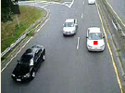
Detecting cars in a video of traffic
Step 5: Visualize Results
Run the following commands to see taggedCars in implay.
frameRate = get(trafficObj,'FrameRate');
implay(taggedCars,frameRate);

Slide 84
Practice
You have recently joined the traffic control department of Lahore as a programmer.
Your 1st task is to make a flow chart and write a pseudo code of your program which can track heavy vehicles (truck etc.) from the video of traffic. Implement your program and do a test run on a video of traffic.
# Now you are promoted as a system administrator. Your next task is to design a system which can track & count the number of vehicles at any crossing with the help of a surveillance camera. Make a flow chart which can guide your programmer to implement the system. Data should be accessible for any slot of times.

Slide 85
# Exercises
1. Morphological and Other Set Operations
(a) Write a computer program capable of performing binary dilation and erosion with an arbitrary structuring element of size 3 x 3 that can be specified by the user.
(b) Write a computer program for performing set intersection, differencing, and complementation (See Section 2.6.4).
2. Boundary Extraction
(a) Use your results from Project 09-01 to implement morphological boundary extraction as in Eq. (9.5-1).
(b) Download Fig. 9.14(a) from the book web site and extract its boundary.

Slide 86
# Exercises
3. Connected Components
(a) Use your results from Project 09-01 to write a computer program capable of extracting
(and counting) the connected components from a binary image.
(b) Download Fig. 9.18(a) from the book web site and approximate the results in Example 9.7.
4. Morphological Solution to Problem 9.36
(a) Use previous results plus any new required techniques and write a computer program to completely solve Problem 9.36.
(b) Download the image from the book web site and solve the problem.

Slide 87
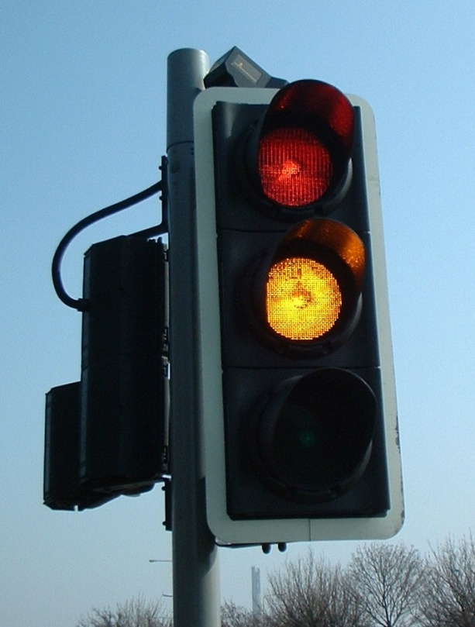
# Exercises
5. Your company asks you to build a cheap traffic light monitoring system. You have a camera that observes a traffic light and should emit events when the light changes the color. How would you proceed?

Slide 88
References
http://www.comp.dit.ie/bmacnamee/gaip.htm

